Slide 1
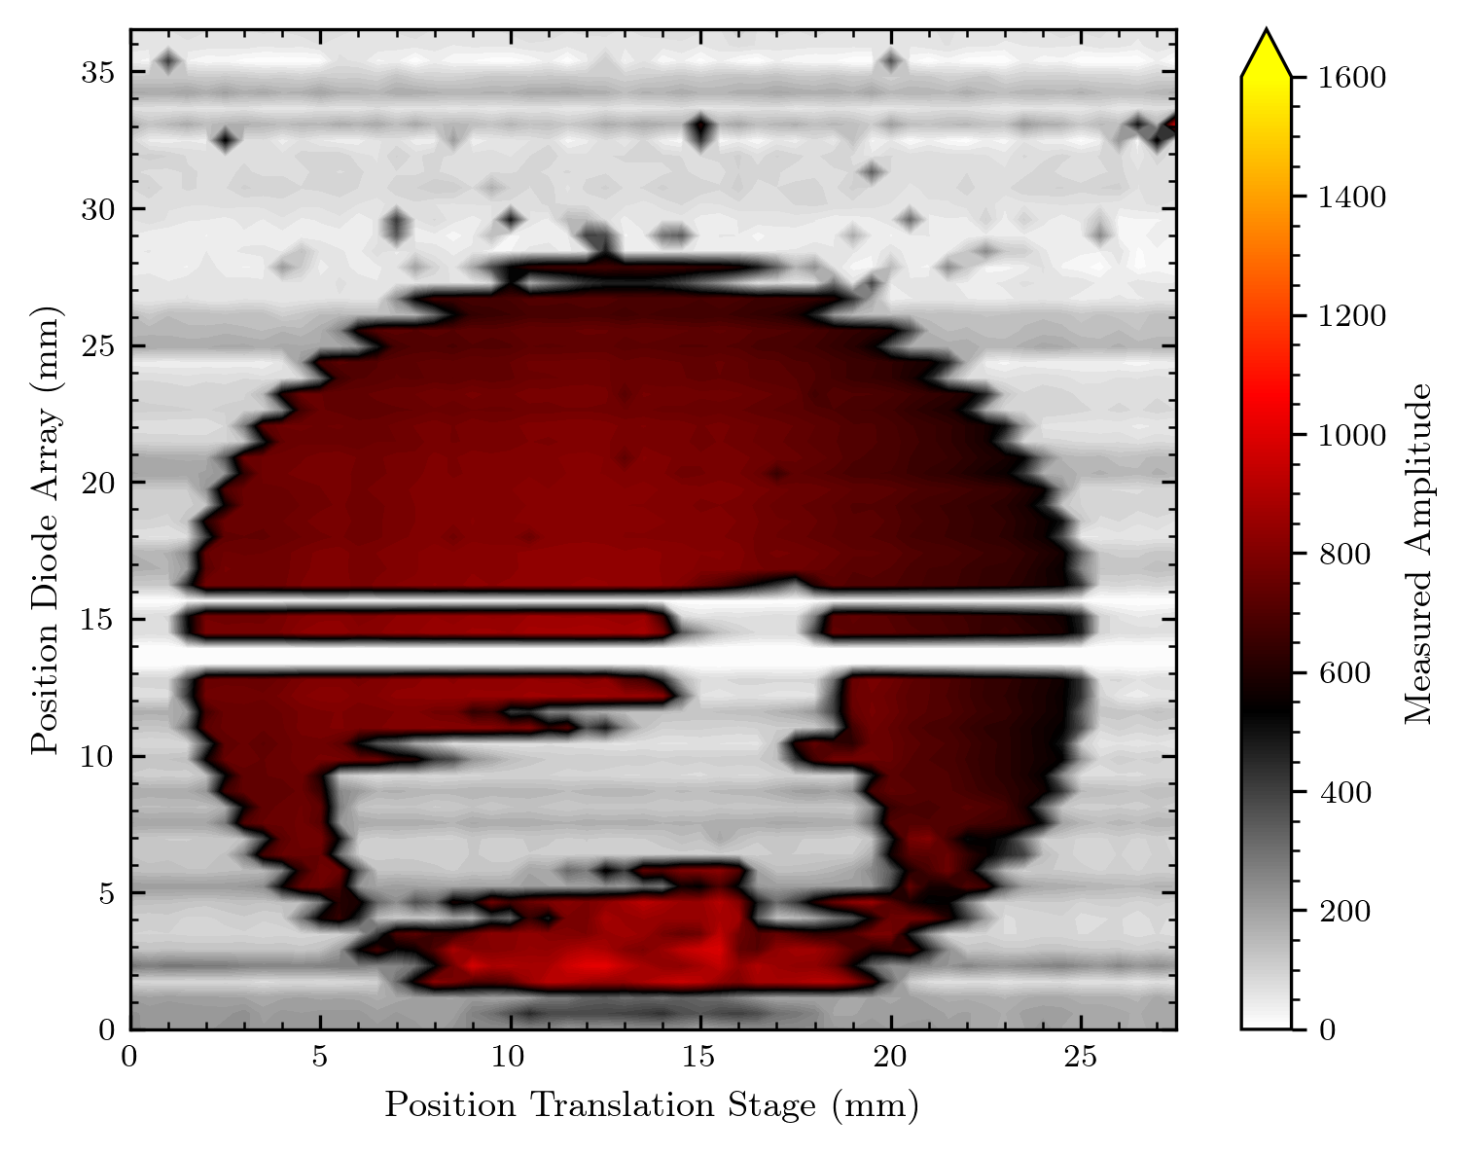






Data Processing and first Proton Beam Imaging
Nico Brosda – Strasbourg Measurements Analysis 06.06.2024

Slide 2
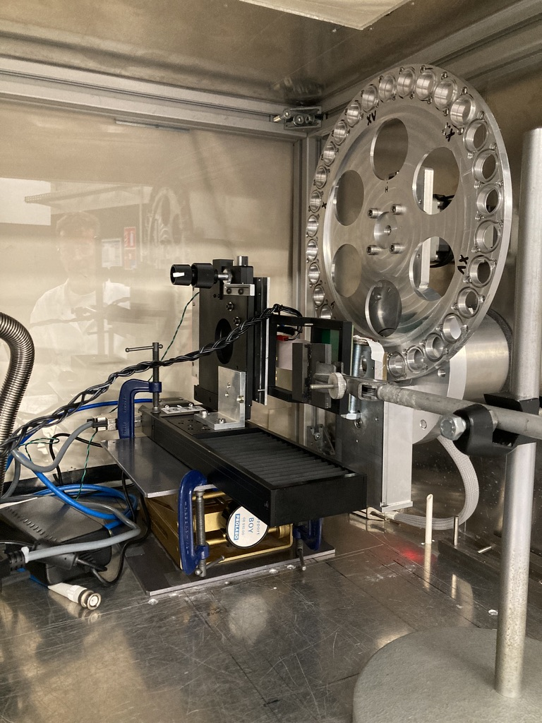
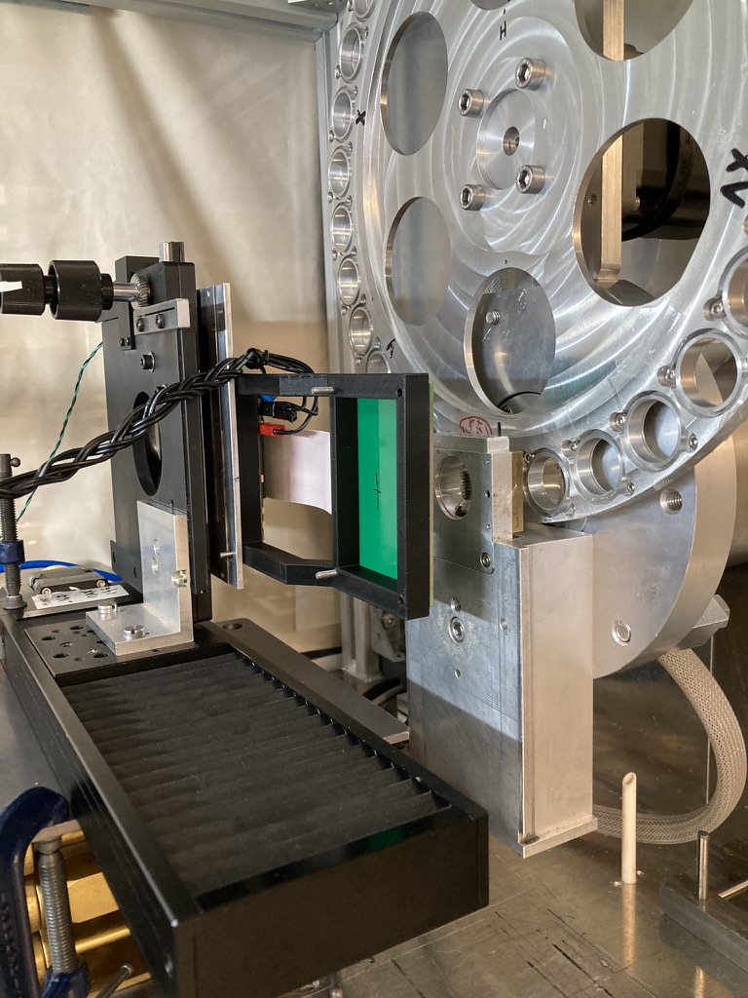
Reminder Setup at Cyrcé
Proton beam with a frequency of 85 MHz or half 42 MHz
Beam Modulated On/Off with 1 s pulse duration
Option to use a diffuser in proton beam line (makes beam more homogenous)
Diodes read out by AMS Test Kit
1D line array of 64 diodes
Stage allows 2D imaging

Slide 3
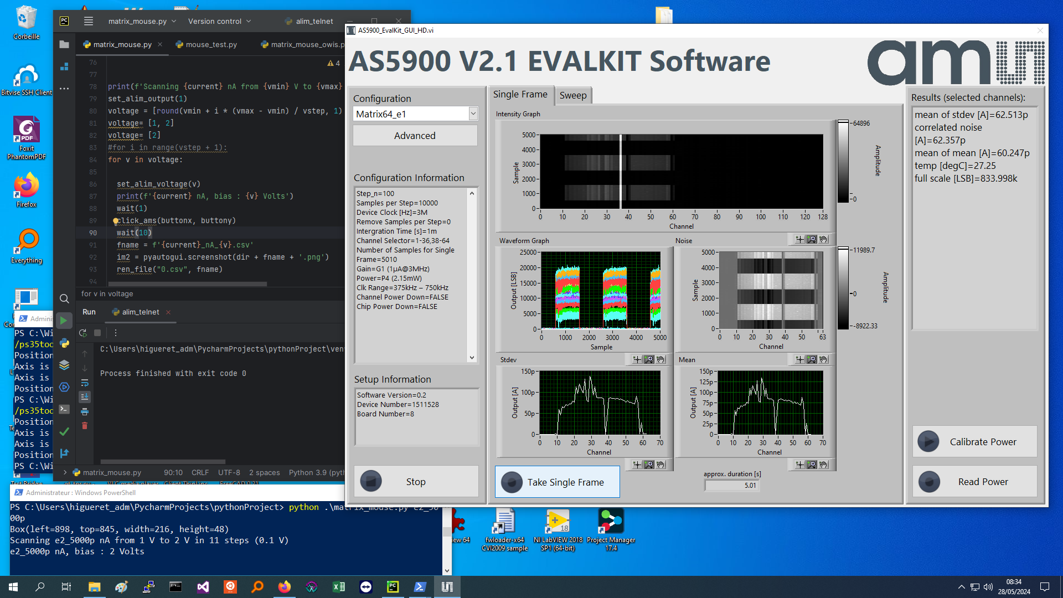
Measurements

Slide 4
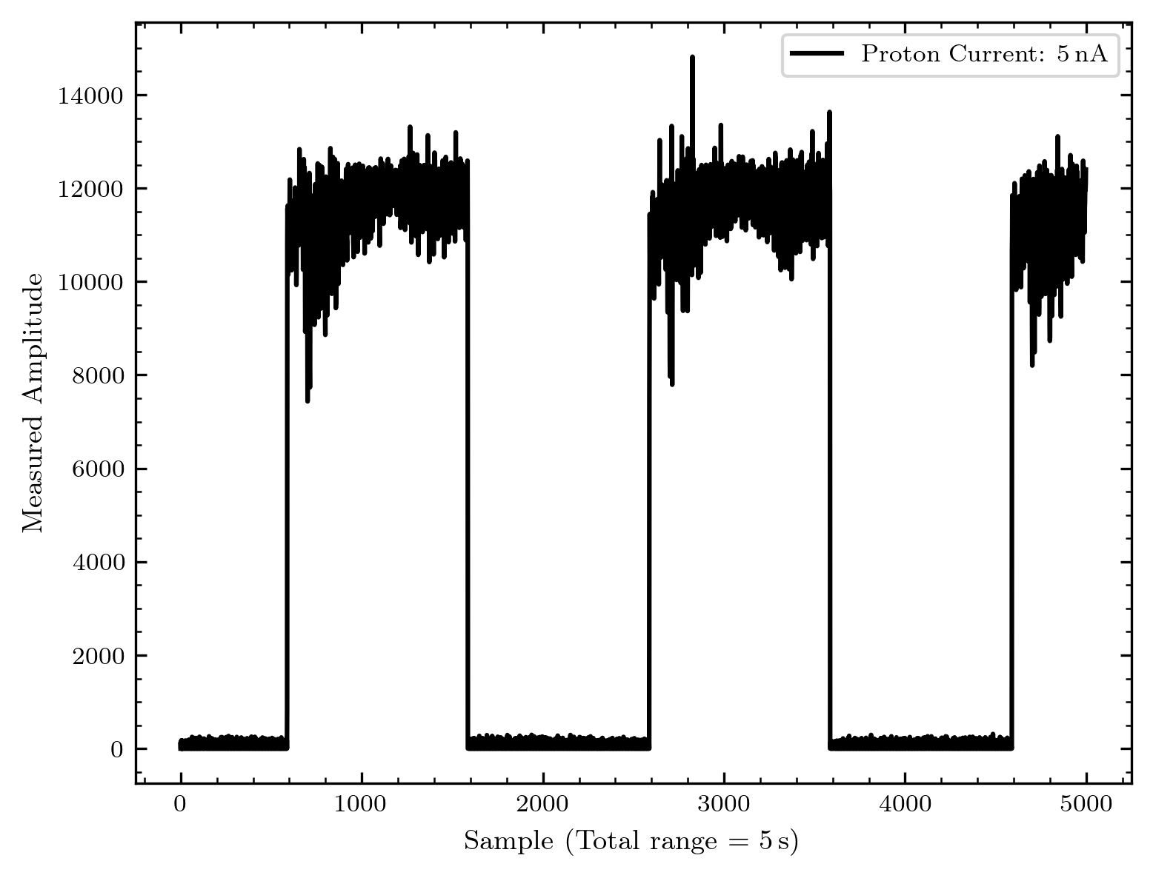
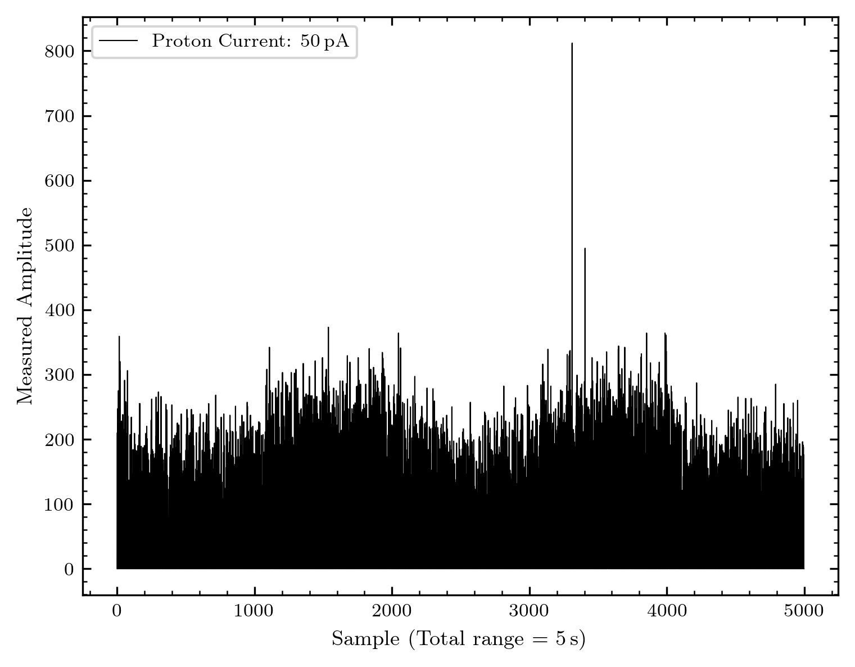
What is measured?

Slide 5
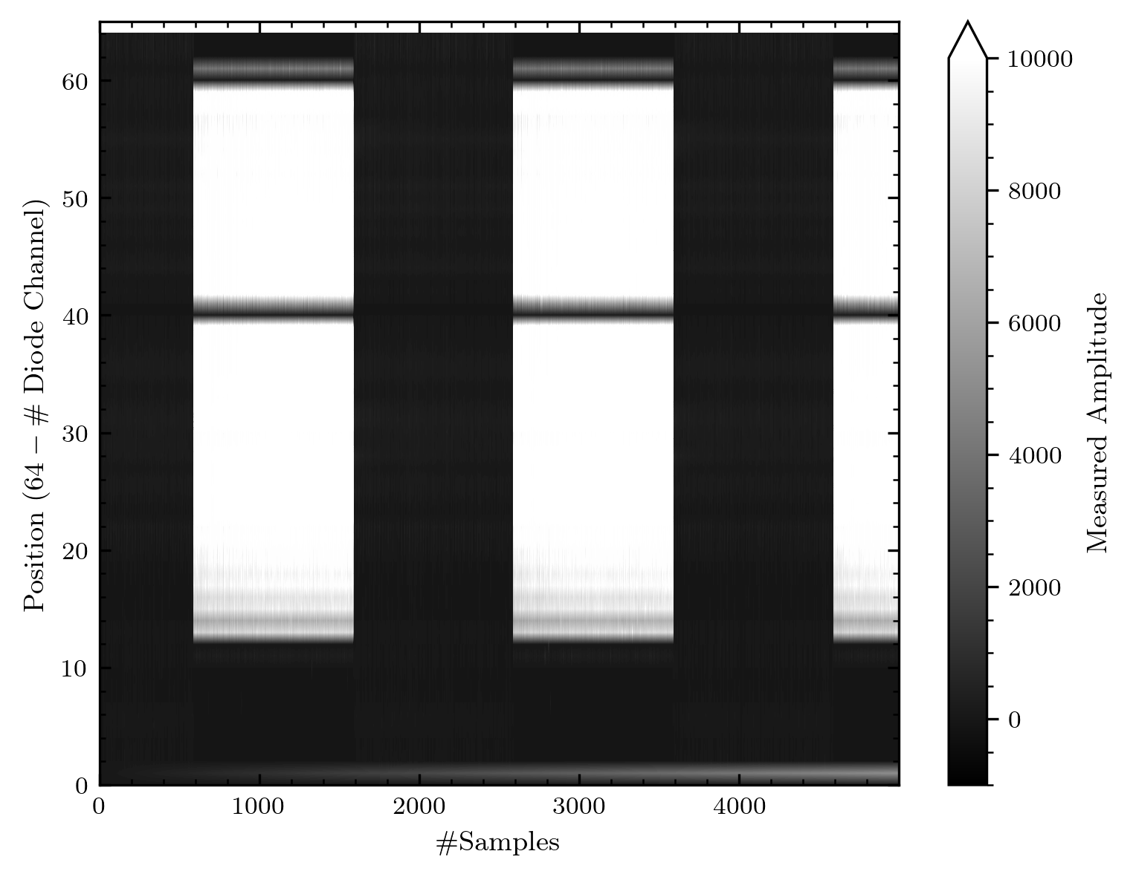
What is measured?

Slide 6
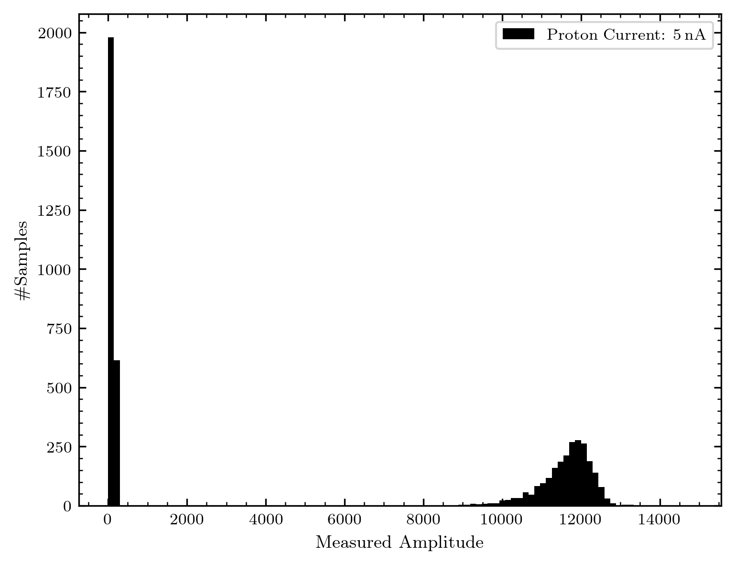
Processing the data

Slide 7
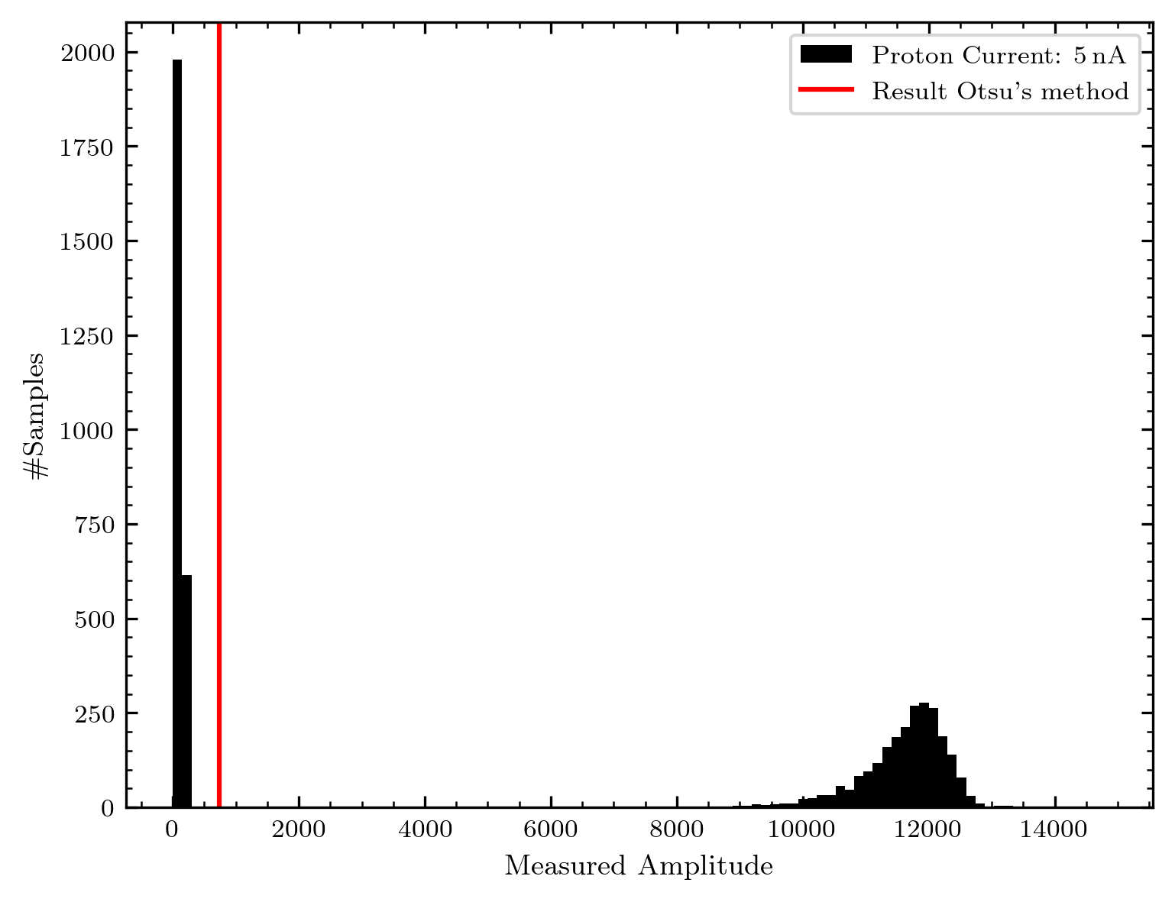
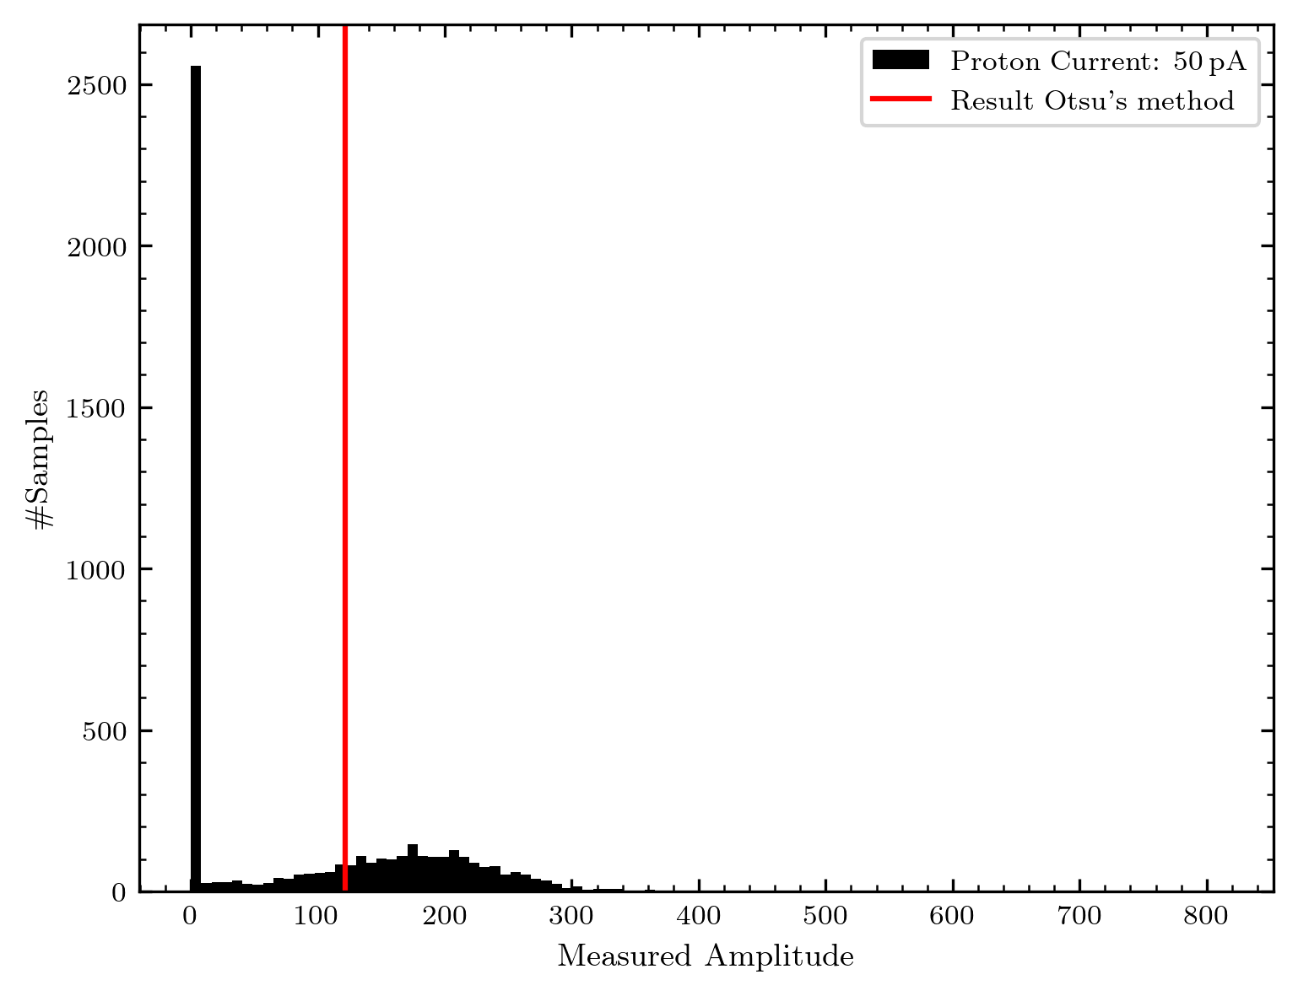
Otsu‘s method

Slide 8

Technical Aspects of data processing
Saved by AMS Software in .csv file (what is easy accessible)
Data structure is…
DAC_in[LSB],Sample,Ch1,Ch2,Ch3,Ch4,Ch5,Ch6,Ch7,Ch8,Ch9,Ch10,Ch11,Ch12,Ch13,Ch14,Ch15,Ch16,Ch17,Ch18,Ch19,Ch20,Ch21,Ch22,Ch23,Ch24,Ch25,Ch26,Ch27,Ch28,Ch29,Ch30,Ch31,Ch32,Ch33,Ch34,Ch35,Ch36,Ch37,Ch38,Ch39,Ch40,Ch41,Ch42,Ch43,Ch44,Ch45,Ch46,Ch47,Ch48,Ch49,Ch50,Ch51,Ch52,Ch53,Ch54,Ch55,Ch56,Ch57,Ch58,Ch59,Ch60,Ch61,Ch62,Ch63,Ch64,Ch65,Ch66,Ch67,Ch68,Ch69,Ch70,Ch71,Ch72,Ch73,Ch74,Ch75,Ch76,Ch77,Ch78,Ch79,Ch80,Ch81,Ch82,Ch83,Ch84,Ch85,Ch86,Ch87,Ch88,Ch89,Ch90,Ch91,Ch92,Ch93,Ch94,Ch95,Ch96,Ch97,Ch98,Ch99,Ch100,Ch101,Ch102,Ch103,Ch104,Ch105,Ch106,Ch107,Ch108,Ch109,Ch110,Ch111,Ch112,Ch113,Ch114,Ch115,Ch116,Ch117,Ch118,Ch119,Ch120,Ch121,Ch122,Ch123,Ch124,Ch125,Ch126,Ch127,Ch128,
1,4,0,0,0,0,0,0,0,0,0,2325,0,35742,28717,39030,37822,42136,39915,43418,42699,47169,45255,66897,57324,70130,63822,57703,76374,48780,46527,79388,73672,55543,66030,5238
1,4,0,0,0,0,0,0,0,0,0,2325,0,35742,28717,39030,37822,42136,39915,43418,42699,47169,45255,66897,57324,70130,63822,57703,76374,48780,46527,79388,73672,55543,66030,52386,51775,50183,51593,49895,0,43902,49838,50820,49832,49907,49765,50803,48533,48989,46736,48412,44285,46514,43639,45490,42963,42094,54298,44958,0,18581,0,0,06,51775,50183,51593,49895,0,43902,49838,50820,49832,49907,49765,50803,48533,48989,46736,48412,44285,46514,43639,45490,42963,42094,54298,44958,0,18581,0,0,0

Slide 9
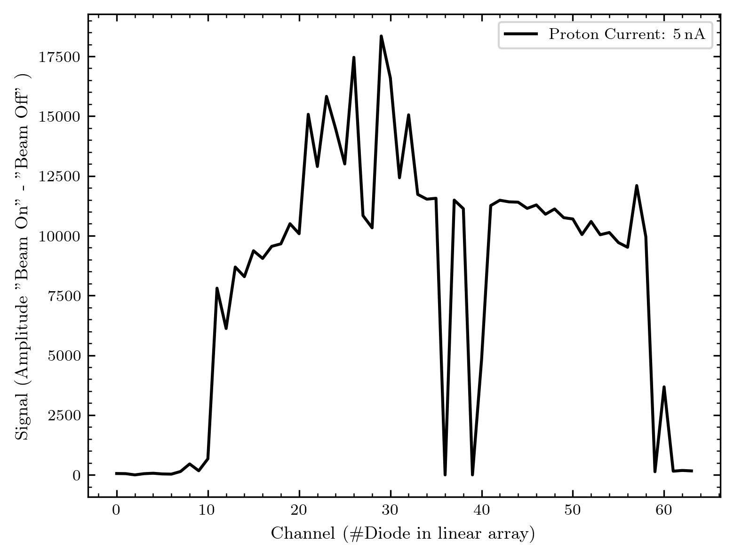
Array response of proton beam

Slide 10
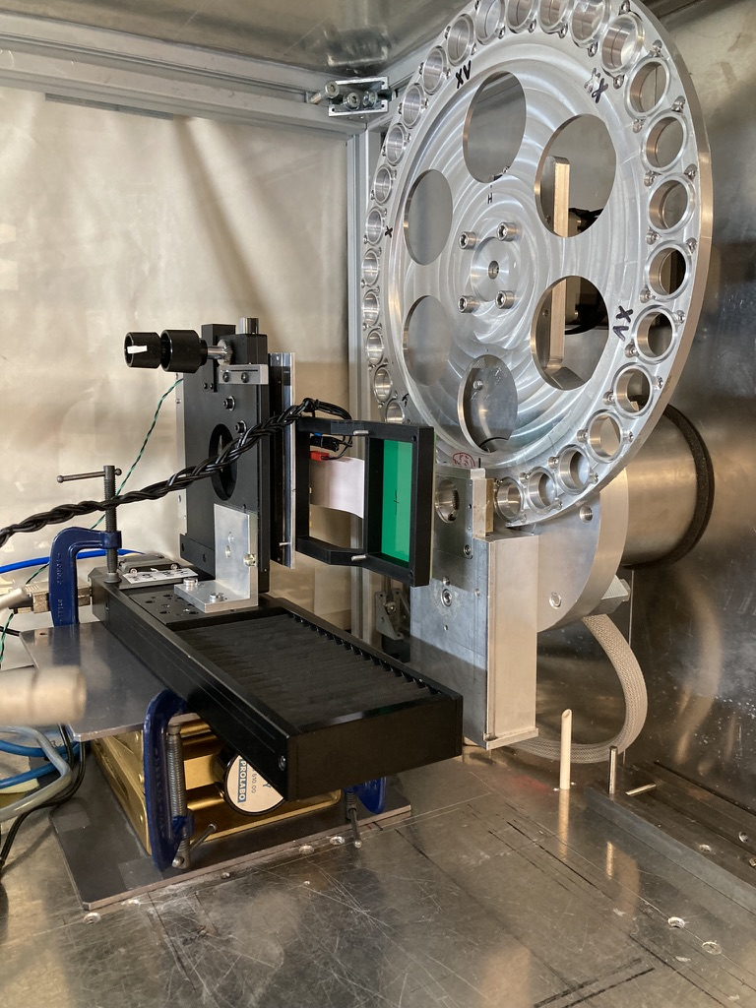
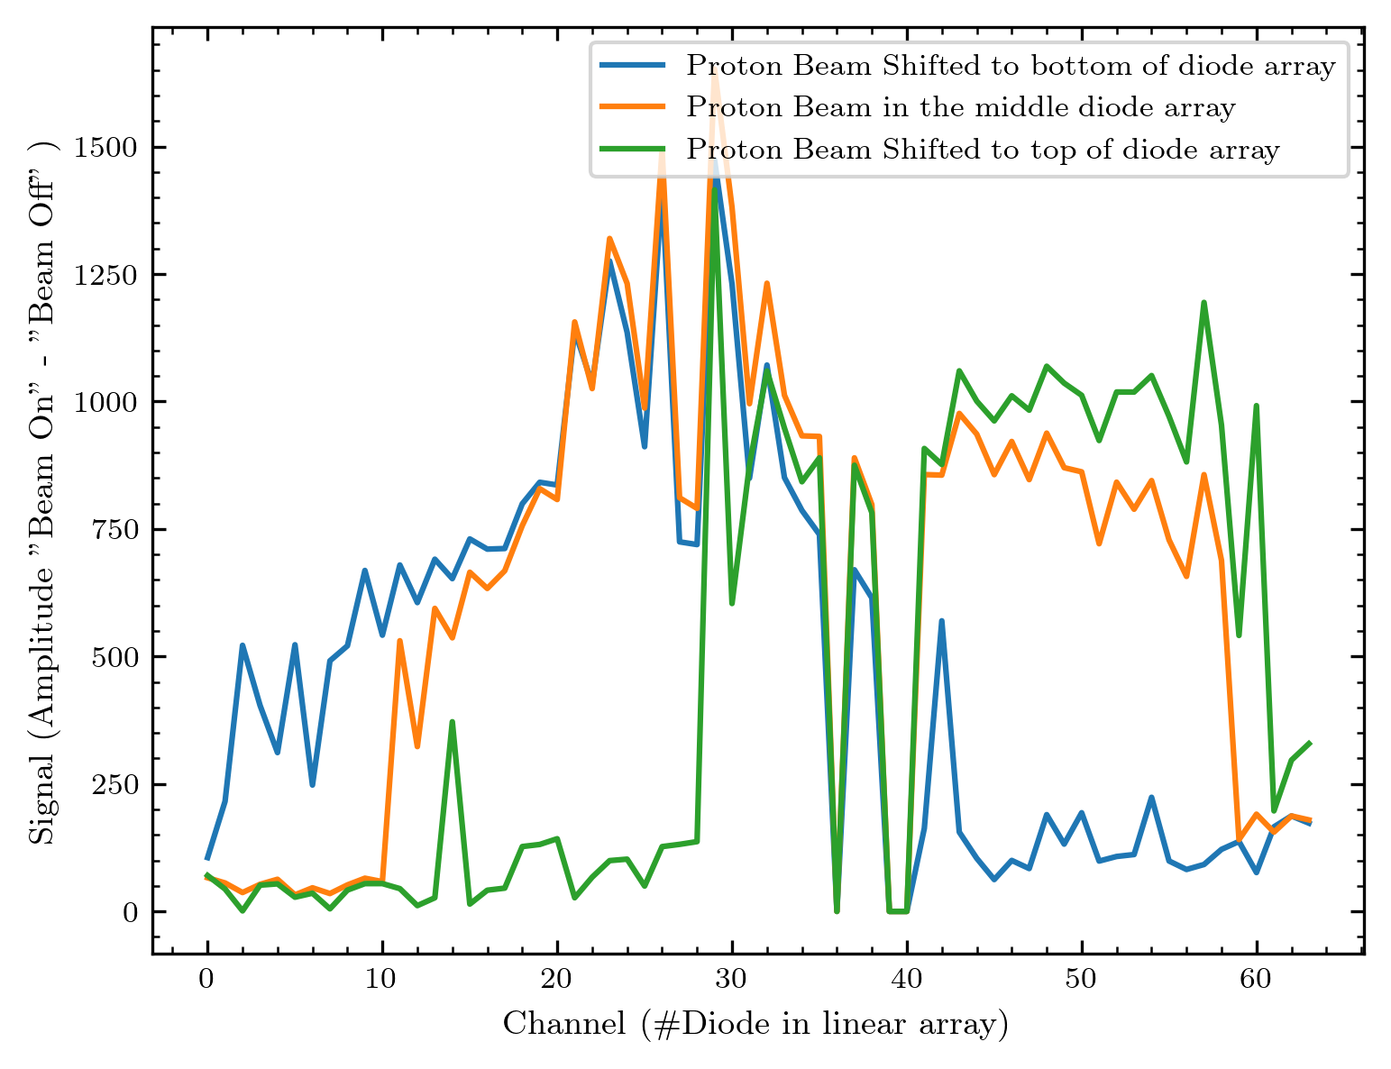
Shifting the diode array in the beam

Slide 11
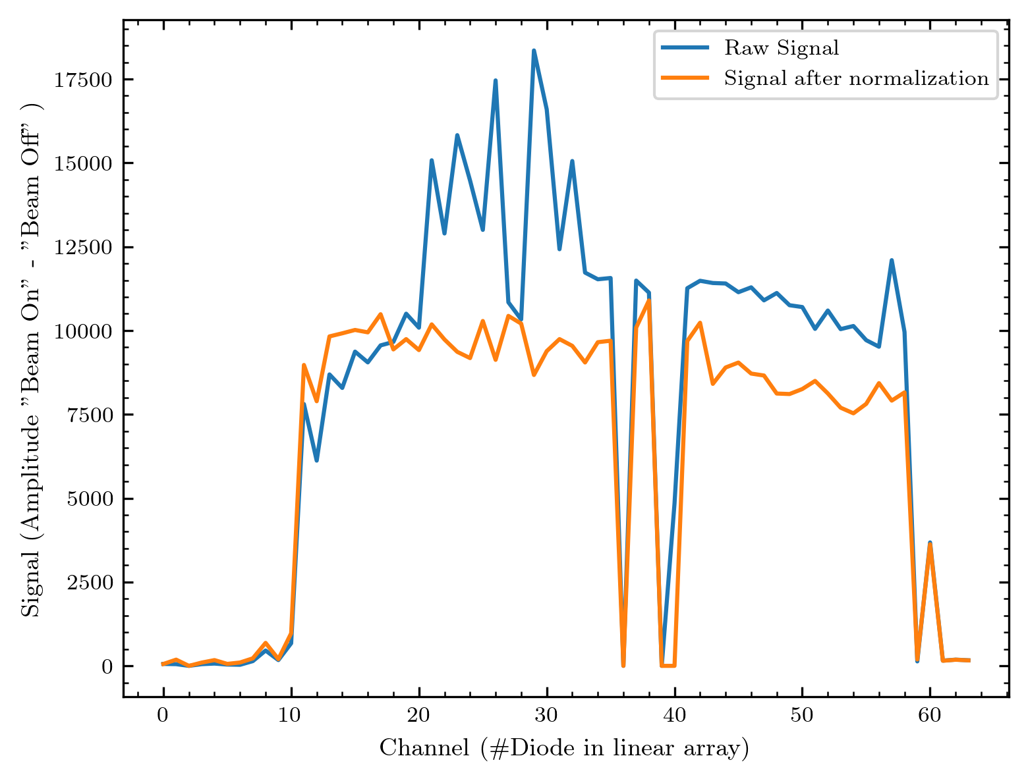
A simple normalization

Slide 12
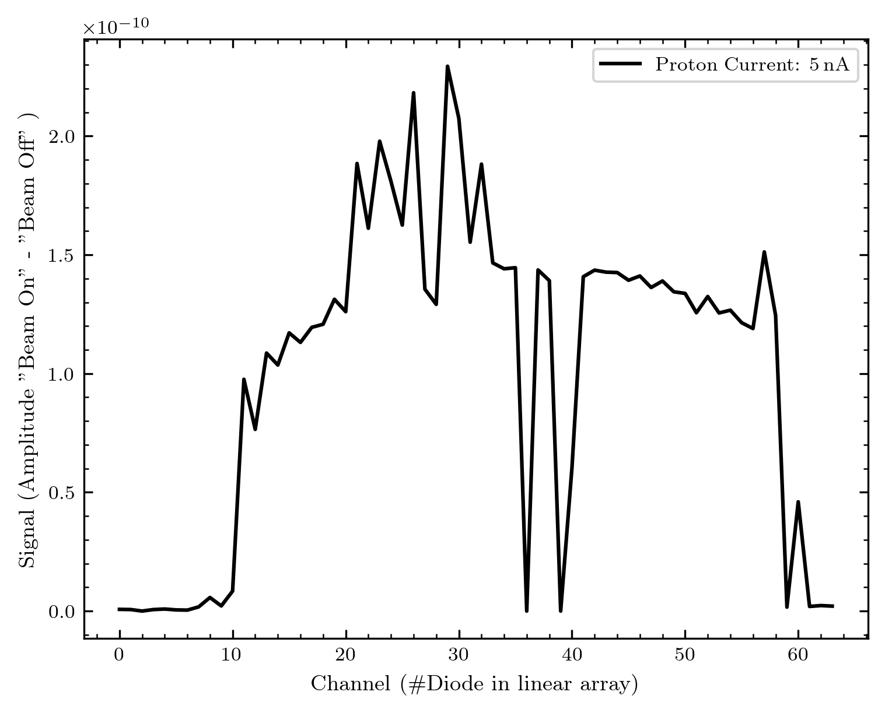
Current Conversion

Slide 13
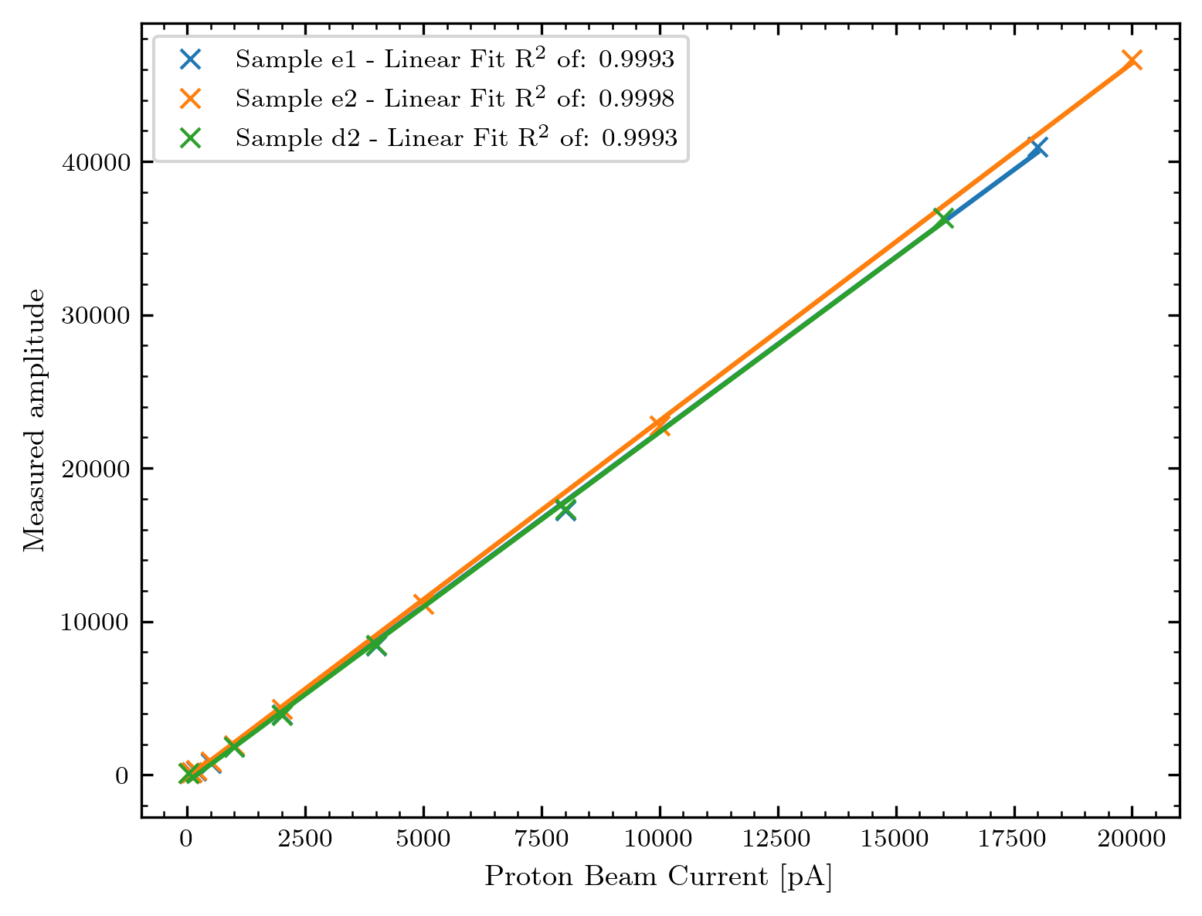
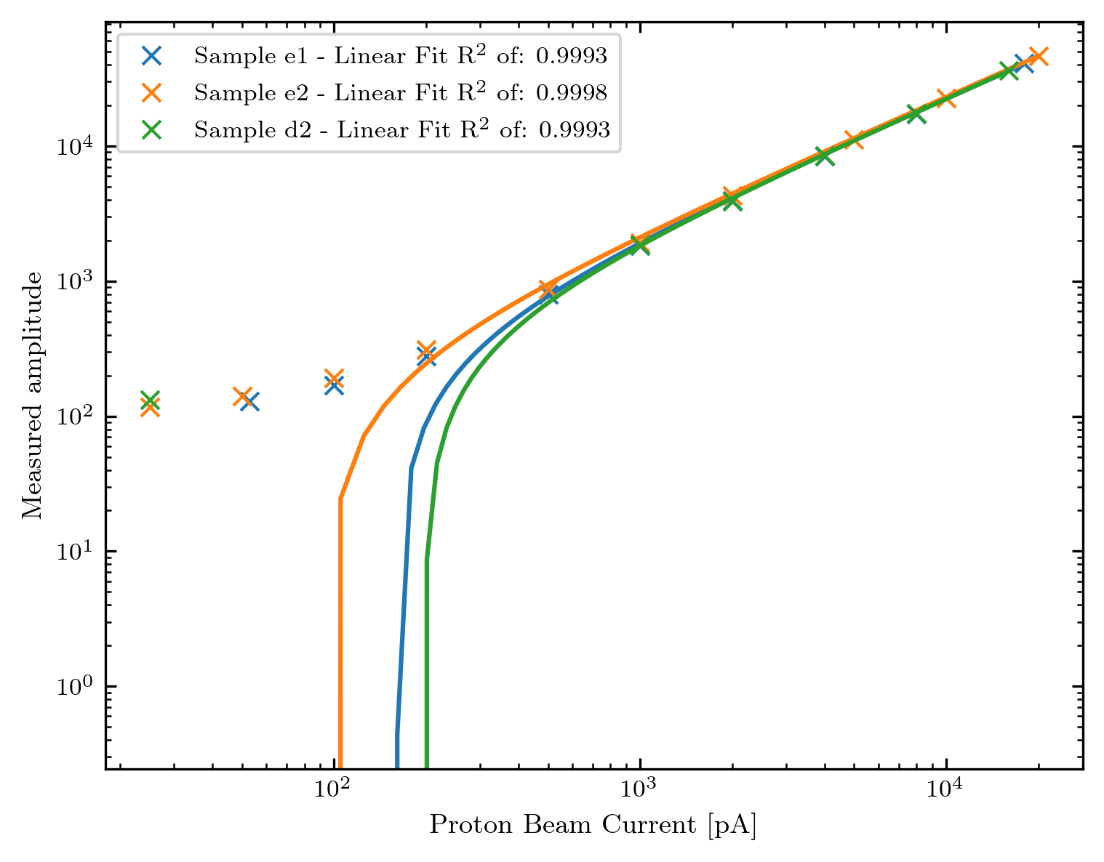
Is the diodes‘ response linear?

Slide 14
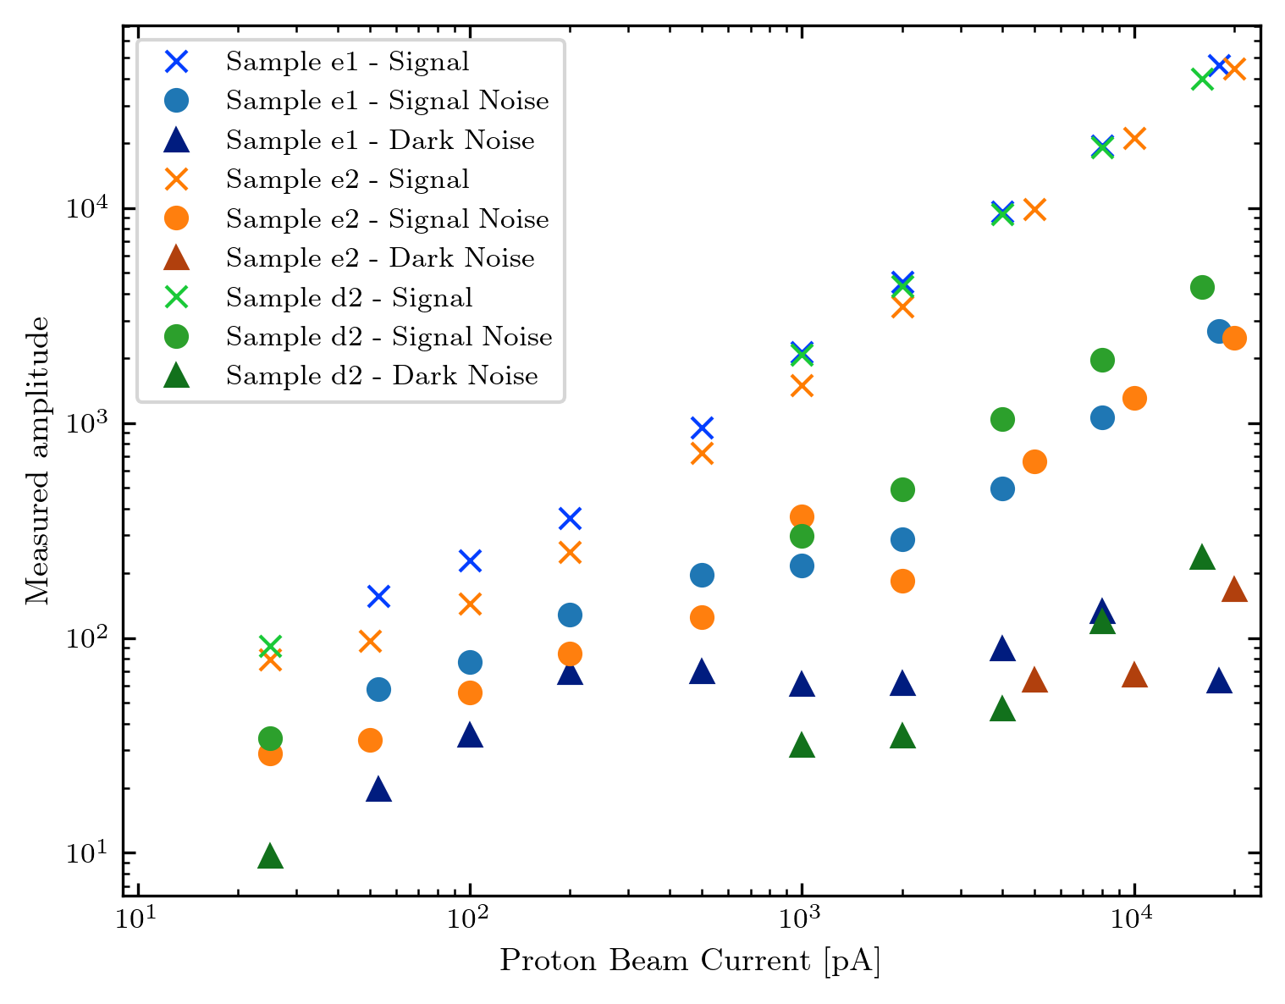
Noise

Slide 15

Imaging
1
0,5 mm x 0,5 mm
y
80 $μm$
2
…
y
x
63
Diode on the left of the stage:
x = 0
64
y = 0
x

Slide 16
Imaging
1
1
0,5 mm x 0,5 mm
y
80 $μm$
2
2
…
…
x
63
63
64
64
x step

Slide 17

Imaging
1
1
0,5 mm x 0,5 mm
y
80 $μm$
2
2
…
…
x
63
63
64
64
x step = 250 $μm$

Slide 18
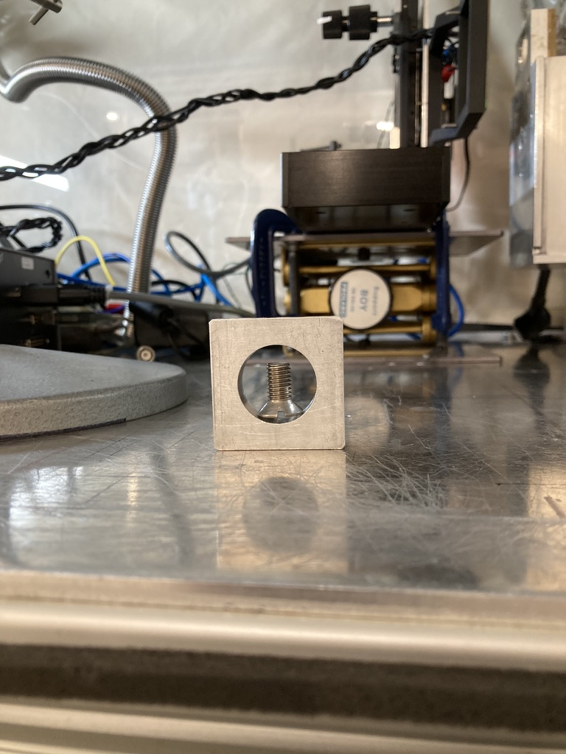
First: Empty round collimator

Slide 19
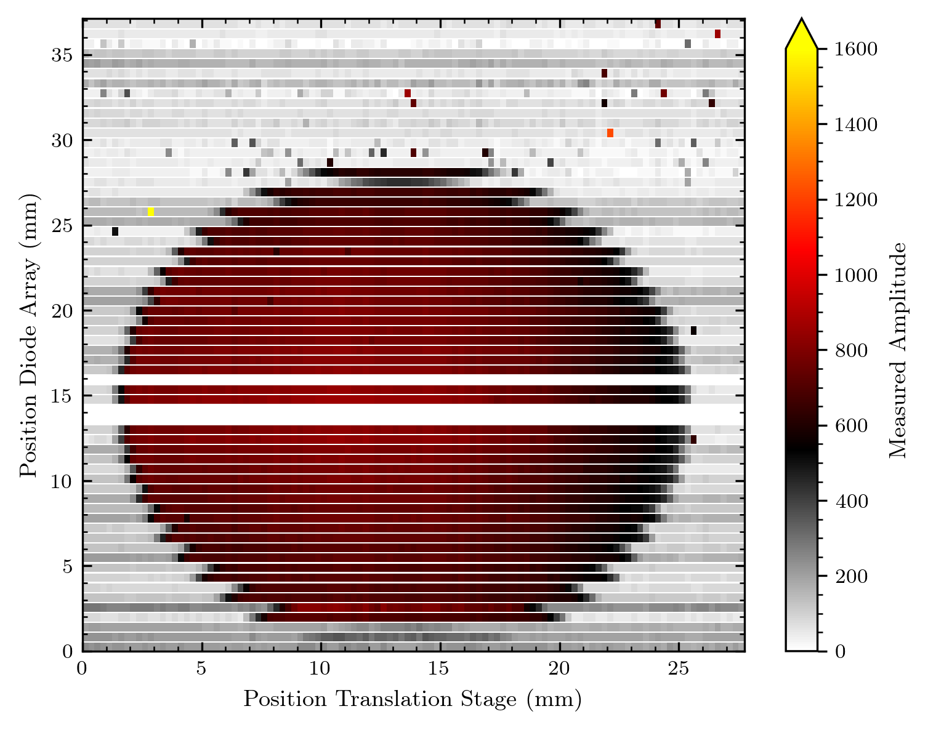
Imaging – Real Image

Slide 20
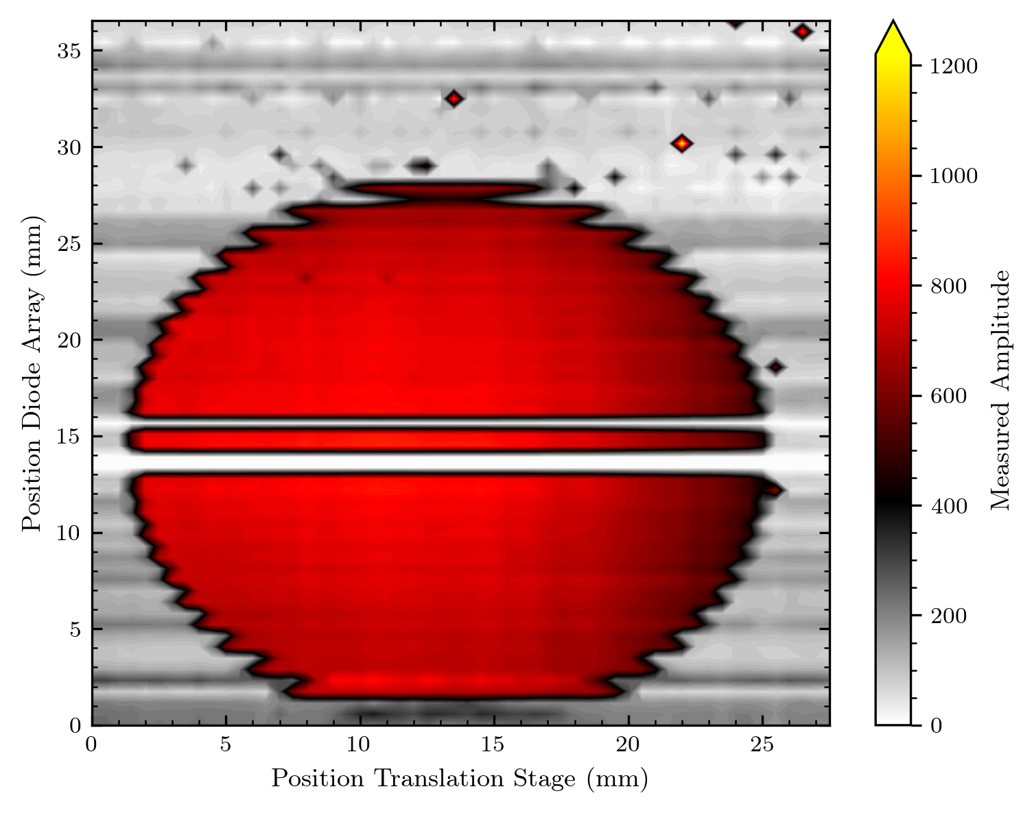
Imaging – Real Image vs interpolated

Slide 21
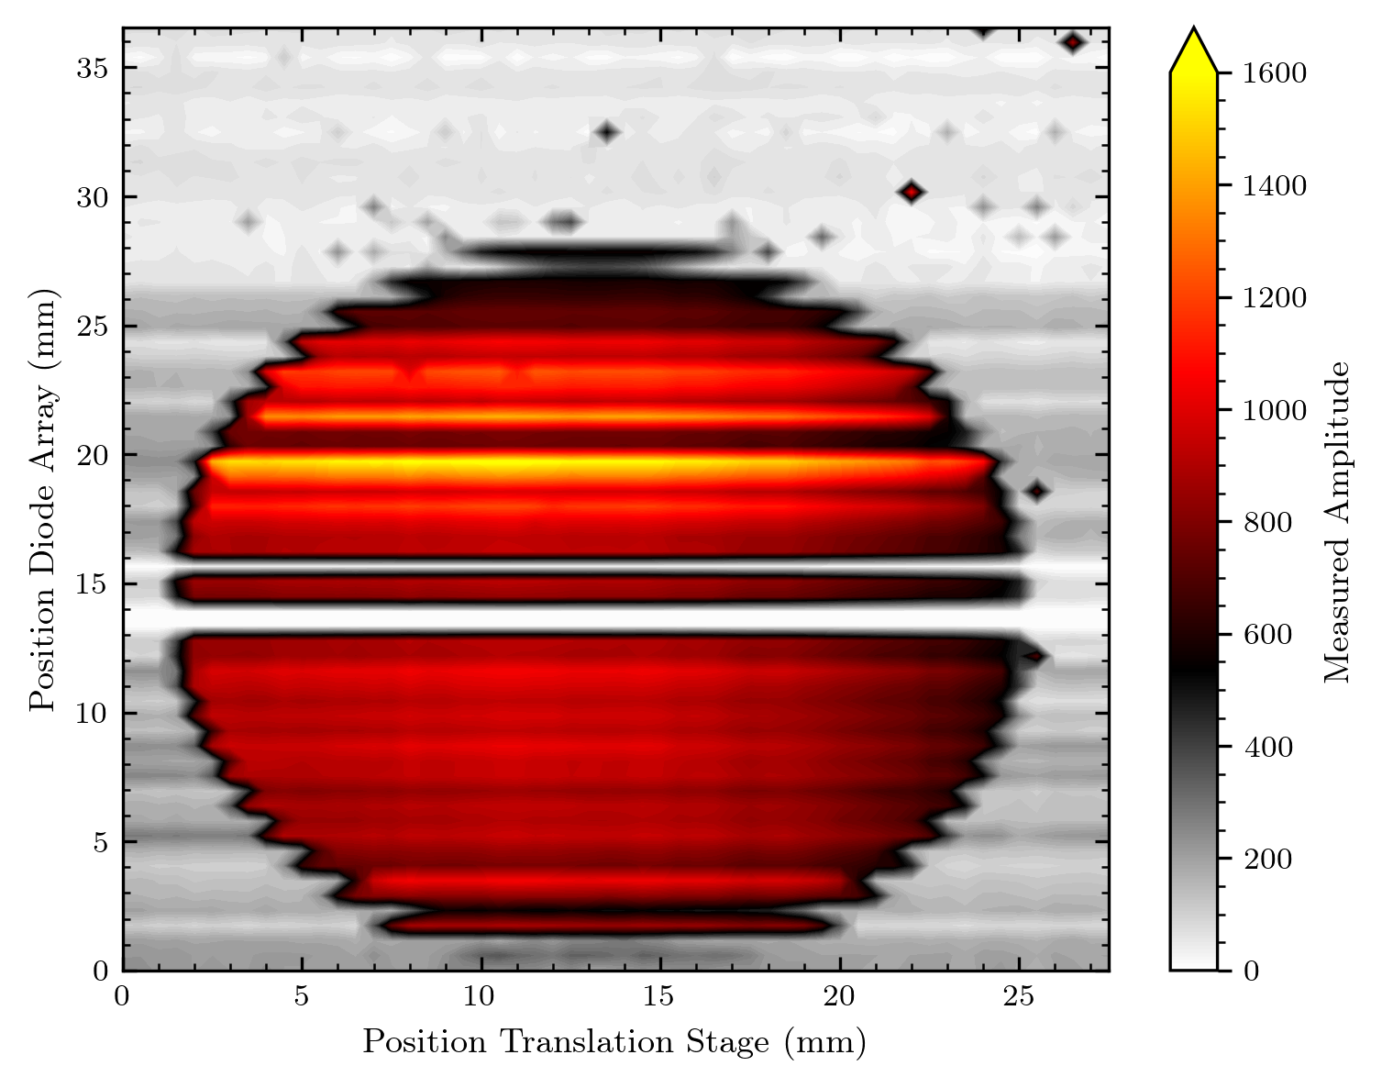
Imaging – Normalization

Slide 22
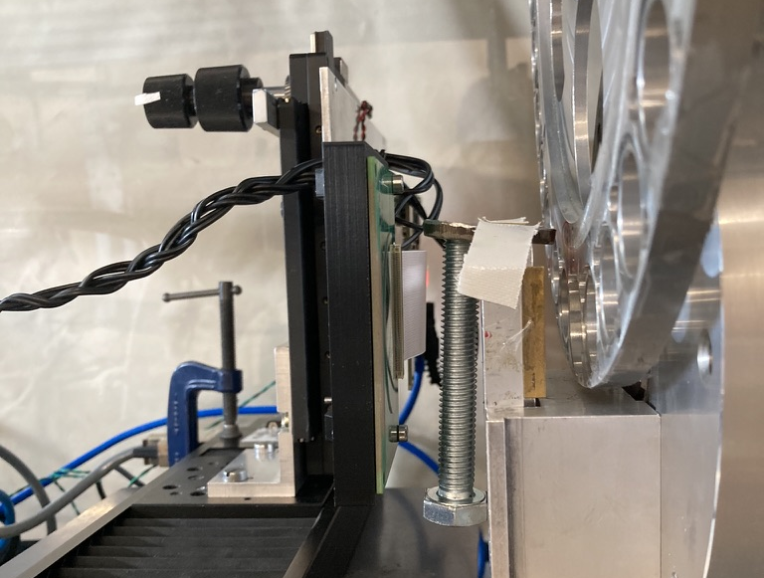
Now: Image Objects (Screws)

Slide 23
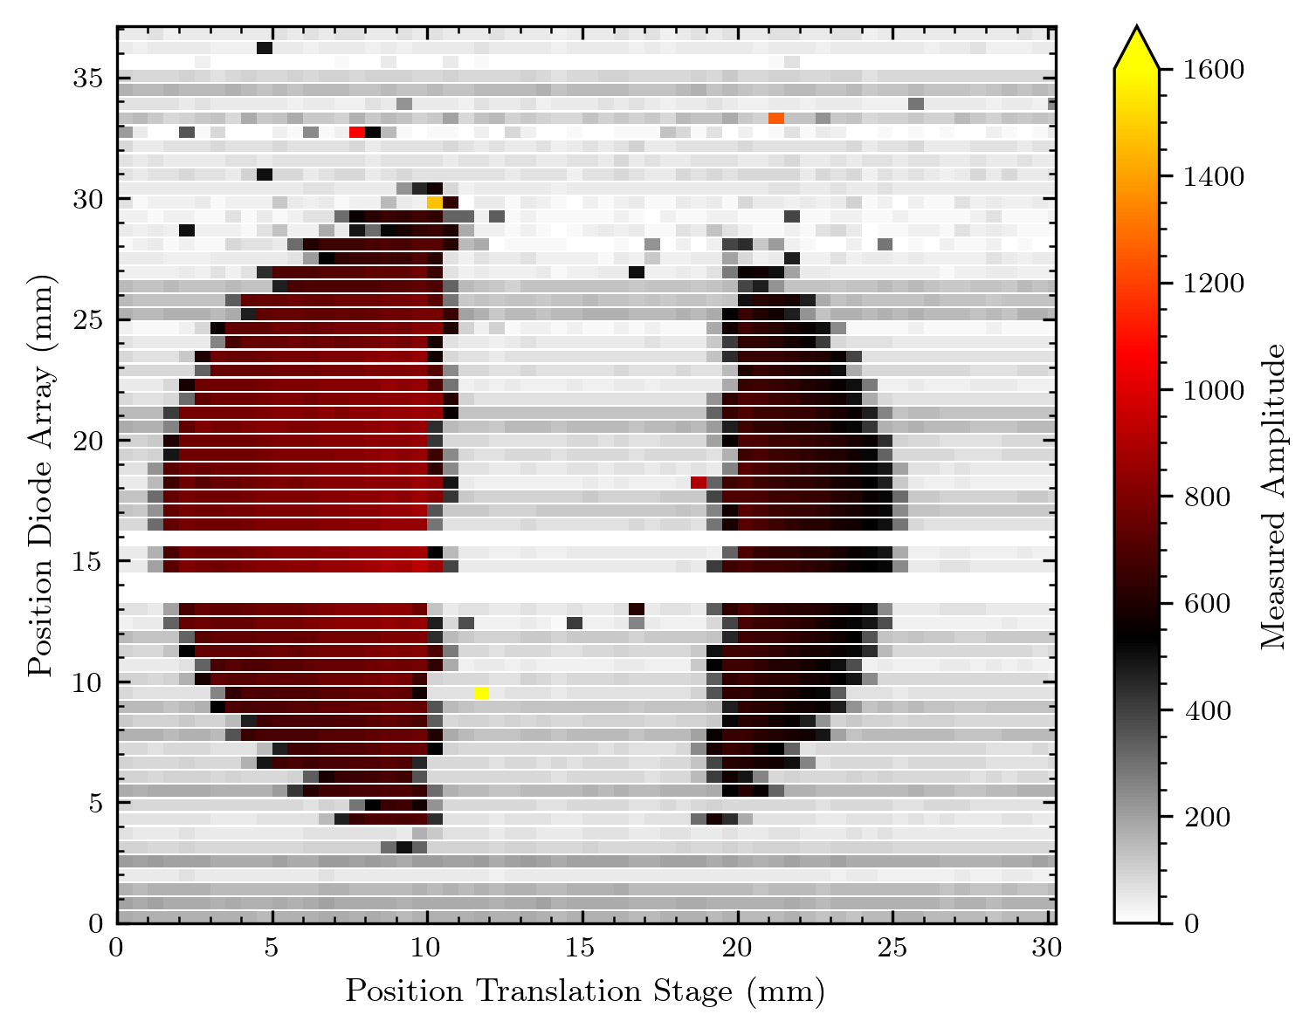
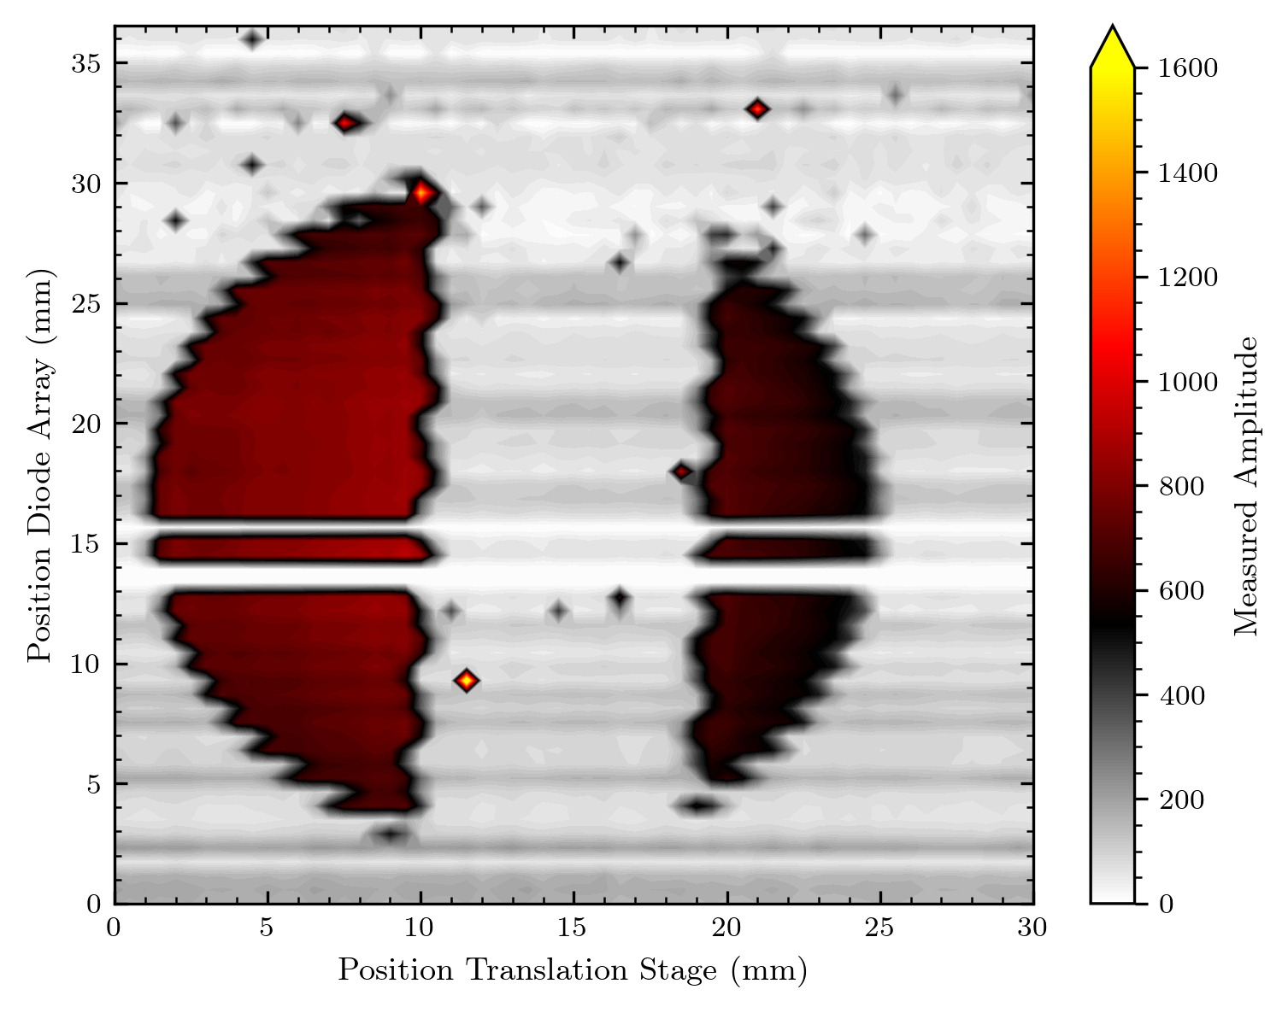
Image Screw

Slide 24
Another screw

Slide 25
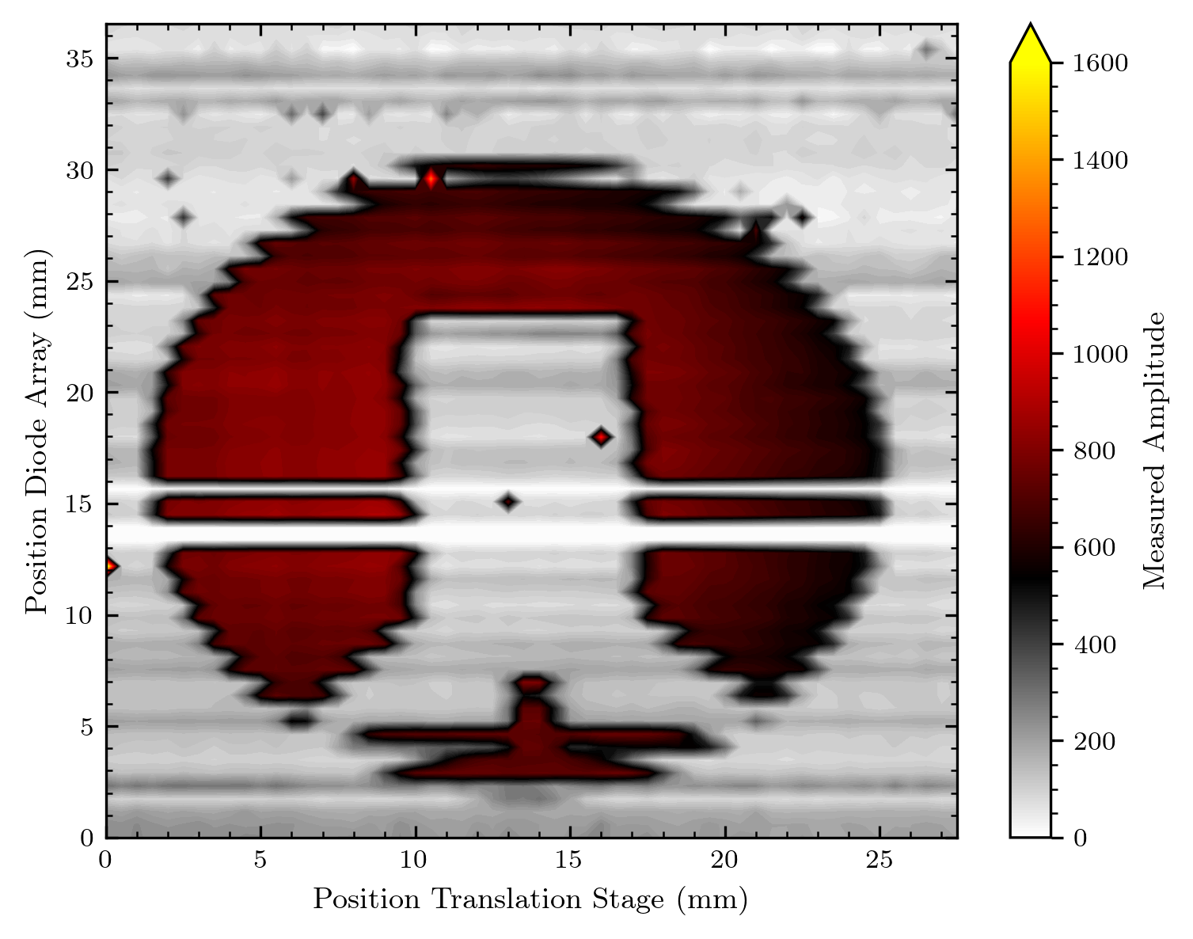
Another screw

Slide 26
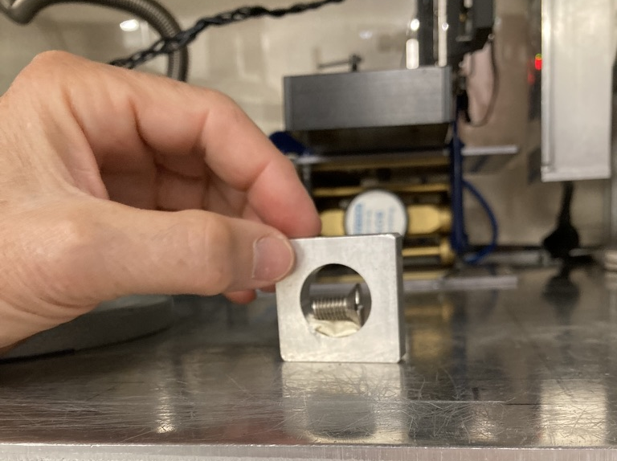
Horizontal screw (but unstable)

Slide 27
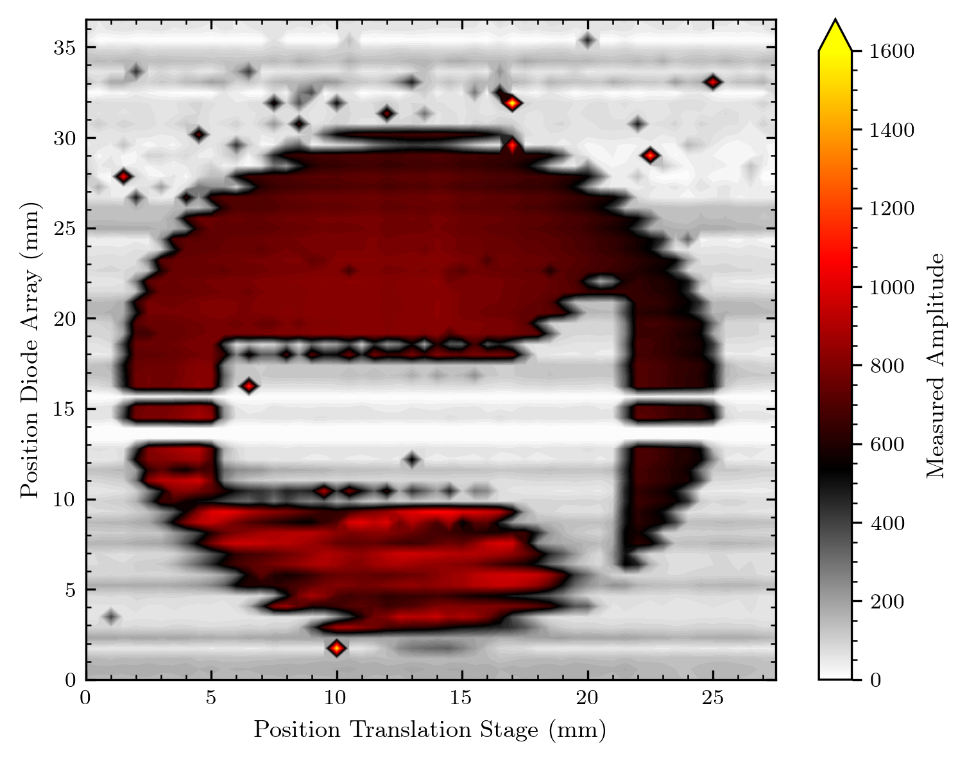
Horizontal screw (but unstable)

Slide 28
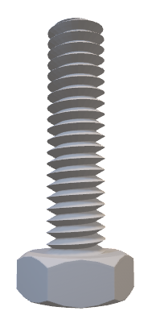
A smaller screw

Slide 29
A smaller screw

Slide 30
Imaging - Sampling
1
1
0,5 mm x 0,5 mm
y
80 $μm$
2
2
…
…
x
63
63
64
64
x step = 250 $μm$

Slide 31

Imaging - Sampling
1
1
y
2
2
So far I‘ve just shown images without this oversampling!
…
…
x
63
63
64
64
x step = 250 $μm$

Slide 32
Imaging - SuperResolution
Step 1
Step 3
Step 5
Step 107
Step 109
Step 111
y
…
Step 2
Step 4
Step 6
Step 108
Step 110
x
…
55 Pixels each
110 Superresolved Pixels

Slide 33
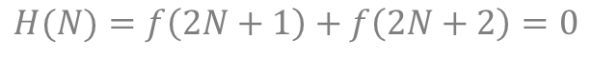
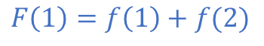
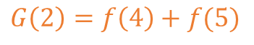
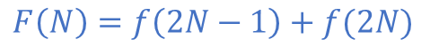
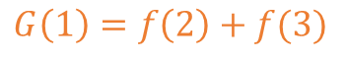
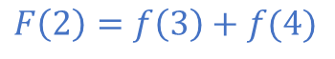
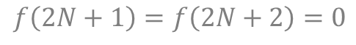
1
2
3
N-1
N
1
2
3
4
5
6
2N-3
2N-2
2N-1
2N
1
2
3
N-1
N
1
2
3
N-1
N
$$F\left(1\right)=f\left(1\right)+f(2)$$
$$G\left(1\right)=f\left(2\right)+f(3)$$
$$H(N)=f\left(2N+1\right)+f\left(2N+2\right)=0$$
$$F\left(2\right)=f\left(3\right)+f(4)$$
$$G\left(2\right)=f\left(4\right)+f(5)$$
$$f\left(2N+1\right)=f\left(2N+2\right)=0$$
$$F\left(N\right)=f\left(2N−1\right)+f(2N)$$
$$G(N)=f\left(2N\right)+f\left(2N+1\right)=f(2N)$$

Slide 34
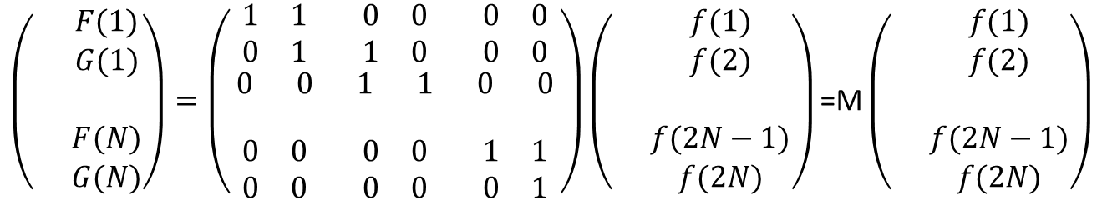
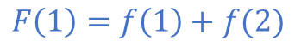
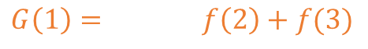
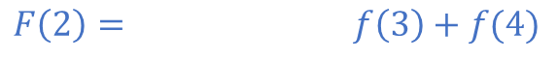
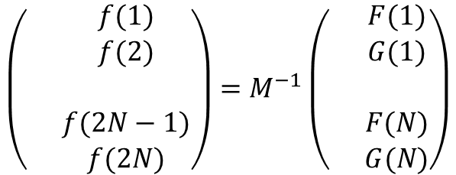
$$F\left(1\right)=f\left(1\right)+f(2)$$
We set a boundary condition on one side; f=0 at the last effective pixel (f(N+1)=0)
$$G\left(1\right)= f\left(2\right)+f(3)$$
$$F\left(2\right)= f\left(3\right)+f(4)$$
$$G\left(2\right)= f\left(4\right)+f(5)$$
$$F\left(N\right)= f\left(2N−1\right)+f(2N)$$
$$G\left(N\right)= f\left(2N\right)$$
$$\left(\begin{matrix} & F(1) \\ & \begin{aligned}G(1) \\ \\ F(N) \\ G(N)\end{aligned}\end{matrix}\right)=\left(\begin{matrix}\begin{matrix}1 & 1 \\ 0 & 1\end{matrix} & \begin{matrix}0 & 0 \\ 1 & 0\end{matrix} & \begin{matrix}0 & 0 \\ 0 & 0\end{matrix} \\ \begin{matrix}0 & 0 \\ & \end{matrix} & \begin{matrix}1 & 1 \\ & \end{matrix} & \begin{matrix}0 & 0 \\ & \end{matrix} \\ \begin{matrix}0 & 0 \\ 0 & 0\end{matrix} & \begin{matrix}0 & 0 \\ 0 & 0\end{matrix} & \begin{matrix}1 & 1 \\ 0 & 1\end{matrix}\end{matrix}\right)\left(\begin{matrix} & f(1) \\ & \begin{aligned}f(2) \\ \\ f(2N−1) \\ f(2N)\end{aligned}\end{matrix}\right)\text{=}\text{M}\left(\begin{matrix} & f(1) \\ & \begin{aligned}f(2) \\ \\ f(2N−1) \\ f(2N)\end{aligned}\end{matrix}\right)$$
$$\left(\begin{matrix} & f(1) \\ & \begin{aligned}f(2) \\ \\ f(2N−1) \\ f(2N)\end{aligned}\end{matrix}\right)=M^{−1}\left(\begin{matrix} & F(1) \\ & \begin{aligned}G(1) \\ \\ F(N) \\ G(N)\end{aligned}\end{matrix}\right)$$

Slide 35
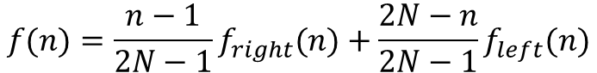
You get one profile with boundary condition at last pixel f(2N+1)=0. Profile f_{right}
You get one profile with boundary condition at first pixel f(1)=0: Profile f_{left}.
On can combine both profiles to get the best profile:
$$f(n)=\frac{n−1}{2N−1}f_{right}(n)+\frac{2N−n}{2N−1}f_{left}(n)$$
This formula makes sure to get 0 on both ends

Slide 36
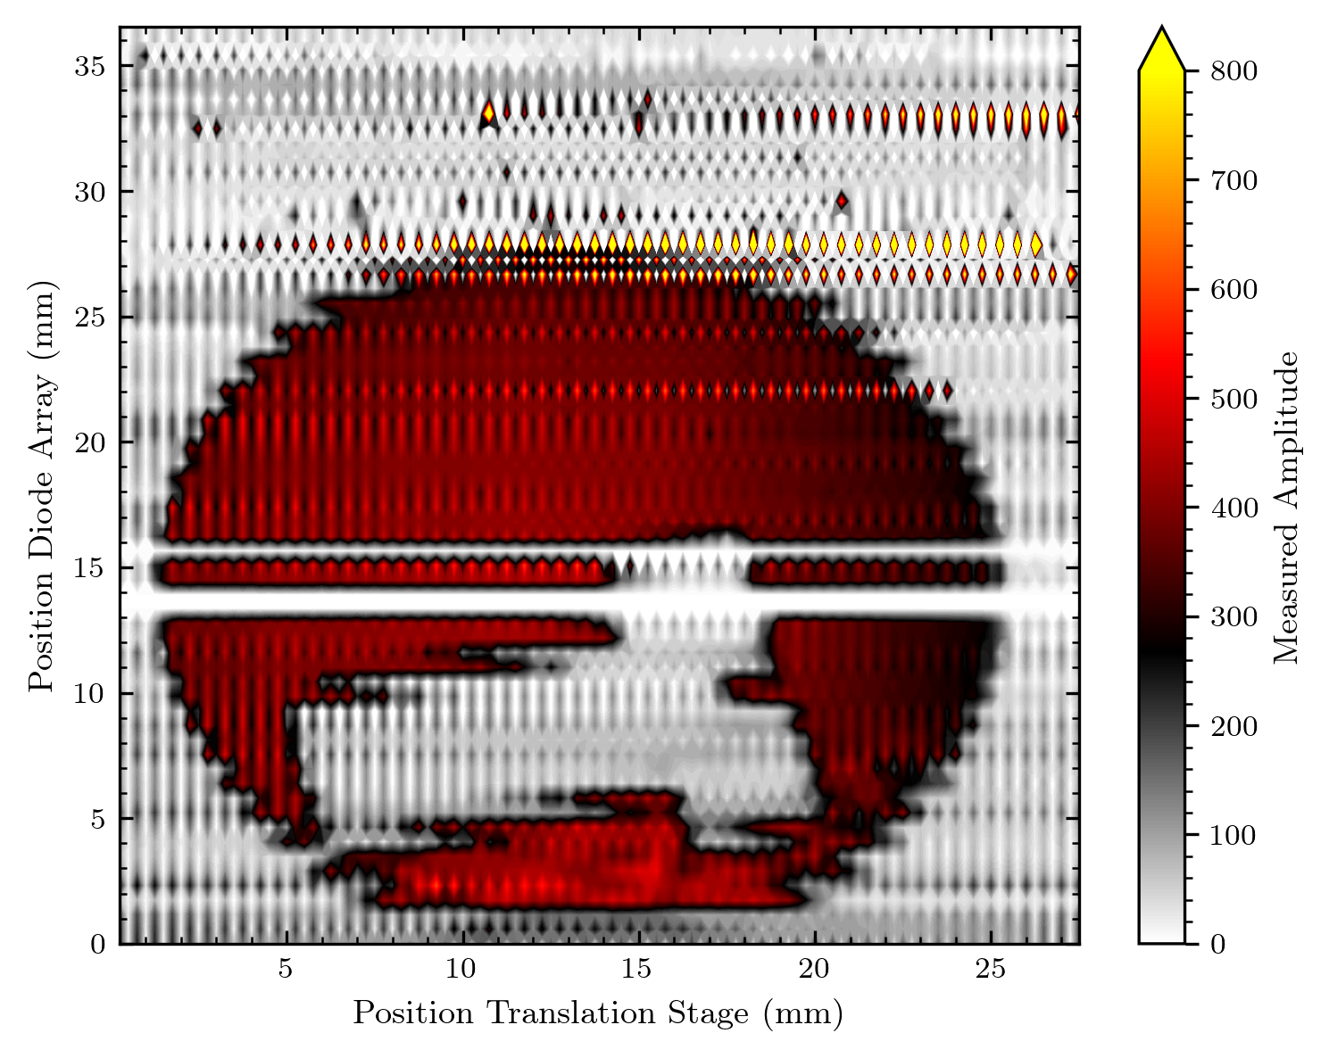
Super Resolution vs Normal Resolution

Slide 37

Super Resolution vs Oversampled Image

Slide 38
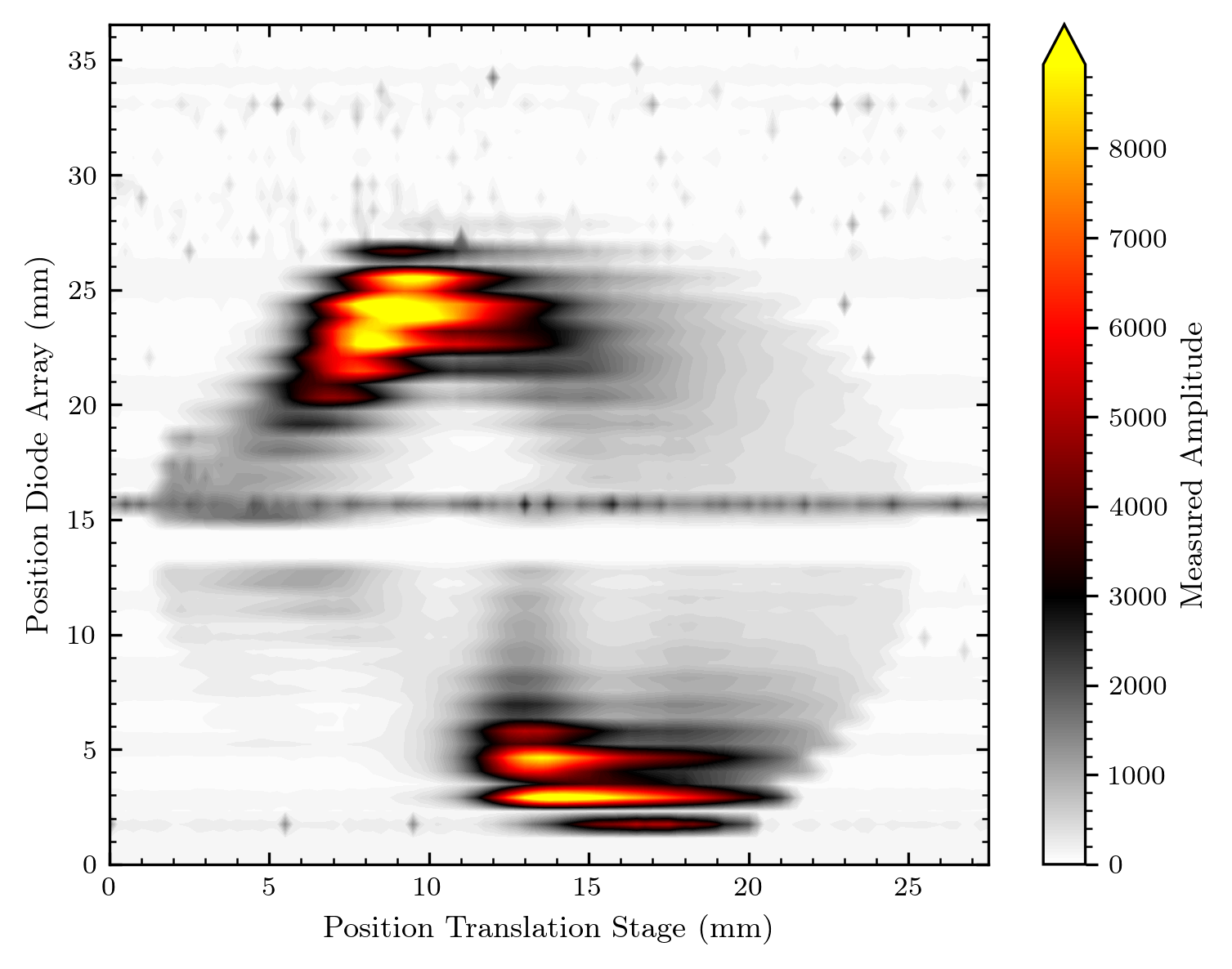
Image of the beam (now without diffuser)

Slide 39
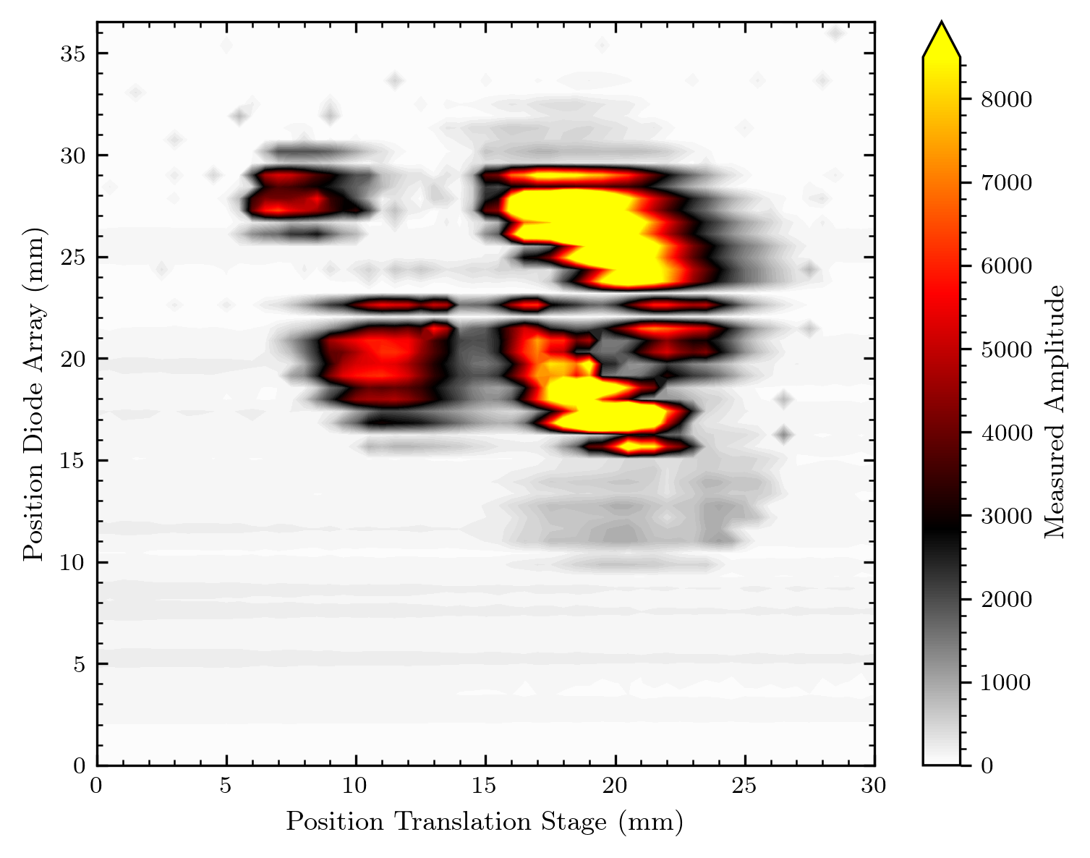
Image of the beam between 2 days (and samples)

Slide 40
What‘s about to come
More measurements in proton beam
Optical setup for diode excitation
Easier studying of AMS circuit parameters
Further process of data analysis (with relation to image processing)
2D array

